Slide 1
Yogesh’s Data Visualization Project Kpi Dashboard for Road Accidents
A Case Study on Road Accident happend from 2021-2022
Duration: 10-15minutes

Slide 2
Problem statement / Project scope
Our client wants to develop a KPI Dashboard for road accidents happened from 2021 to 2022
Primary KPIs:
Maximum casualties by Vehicle type
Total casualties and percentage of total with respect to accident severity.
Secondary KPIs:
Total casualties with respect to Vehicle Type
Monthly Trend showing comparison of casualties for current and previous years
Maximum casualties by road type
Distribution of total casualties by road surface
Relation between casualties by area and light conditions

Slide 3
Solution approach
There is one table provided which has 3.7 lakhs rows and 21 columns in it
Microsoft Excel was the tool used for creating the visualization/dashboard
The data was imported, analysed and transformed as per necessity
Pivot table was used to create different KPIs for the problem statement
KEY SKILLS
Pivot Table
Pivot charts
Slicers
Formulae
Calculations

Slide 4
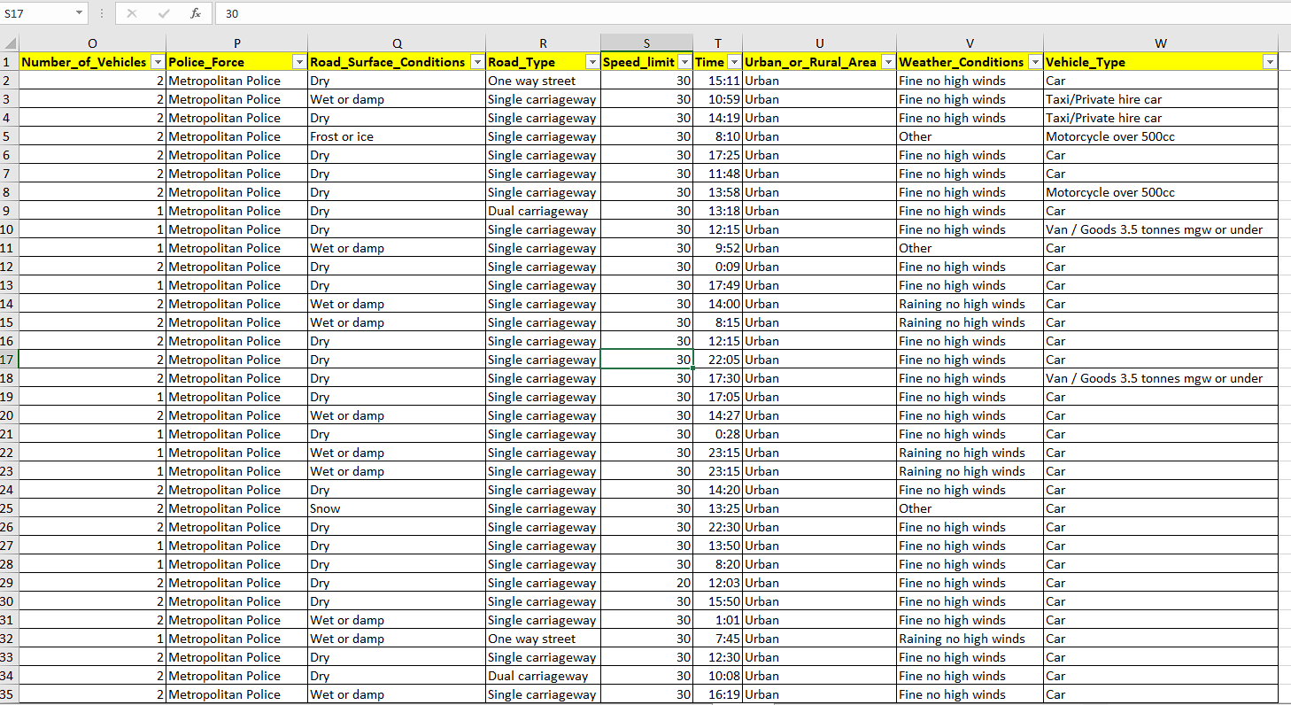
Data cleaning/transformation

Slide 5
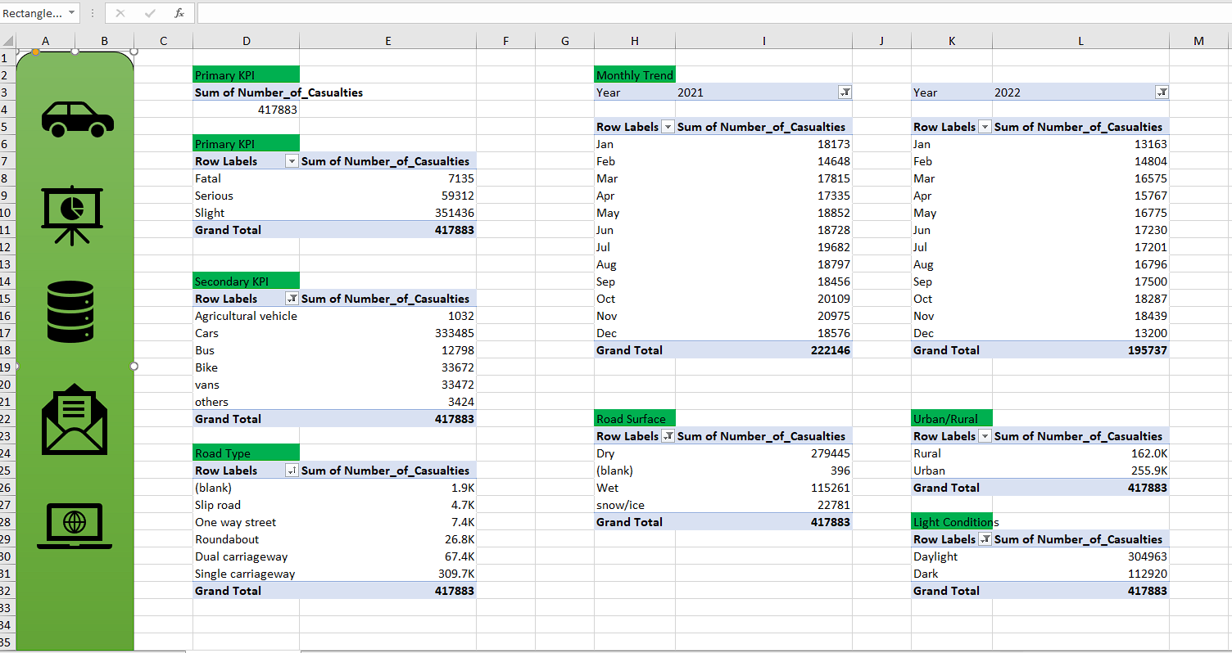
KPIS Made using pivot table

Slide 6
Solution approach
A few measures were created to calculate the KPIs as shown below:
Fatal severity % = fatal severity /(fatal severity + serious severity + slight severity)
Serious severity% = serious severity /(fatal severity + serious severity + slight severity)
Slight severity% = slight severity /(fatal severity + serious severity + slight severity)
Total casualties = fatal severity + serious severity + slight severity

Slide 7
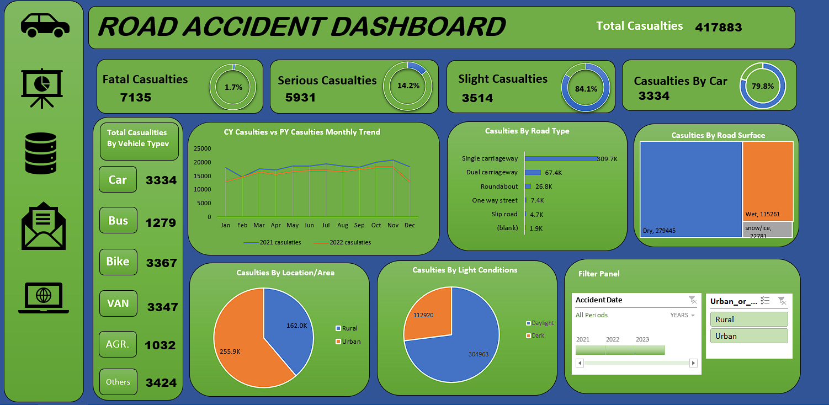
Dashboard

Slide 8
Features of the dashboard
The following 5 visuals were provided:
CY and PY Monthly Trends=the line charts shows the casualties trend between the months of previous and current year showing that most casualties happened between October and November
Casualties by road type=This bar charts shows us that single carriageway leads to most casualties
Casualties by road surface=This tree map shows that dry road type has the most casualties
Casualties by location= Pie chart shows that urban areas has the most casualties
Casualties by light conditions = Pie chart shows that dark conditions has the most casualties

Slide 9
Features of the dashboard
A bunch of Slicers were placed in the right to show the values of important KPIs
The following filters were provided to slicers :
Month-year
location
The theme of the dashboard is just randomly chosen
The visuals are interactive in nature

Slide 10
Problem outcomes
The following are some important insights derived from the dashboard:
Most casualties happened by car type is cars (3334).
We found out that single carriageway leads to the most casualties.
Dry roads were where most casualties has taken place.
Urban areas is where most of the casualties happens.
Night time is when most of the casualties take place.

Slide 11
Conclusion
A Road accident dashboard was built for Stakeholders depicting its various KPIs visually
Relevant filters and interactions was provided in the dashboard
This dashboard can be used for both high-level and in-depth analysis of KPIs across various dimensions
The dashboard may not look good and design is not great as I prefer them making in power BI , but this is a Excel project so I have to create this one on excel

Slide 12
Thank you!

